Slide 1



Missing data handling
Applied statistics and Experimental Design
Group 18
Tran Cong Duy 20214885
Tran Hoang Duong 20214888
Nguyen Hai Duong 20214887
Nhu Minh Ha 20212784
Nguyen Trung Truc 20214936

Slide 2
CONTENTS OF THIS TEMPLATE
You can delete this slide when you’re done editing the presentation
FONTS | To view this template correctly in PowerPoint, download and install the fonts we used
USED AND ALTERNATIVE RESOURCES | An assortment of graphic resources that are suitable for use in this presentation
THANKS SLIDE | You must keep it so that proper credits for our design are given
COLORS | All the colors used in this presentation
ICONS AND INFOGRAPHIC RESOURCES | These can be used in the template, and their size and color can be edited
EDITABLE PRESENTATION THEME | You can edit the master slides easily. For more info, click here
For more info: SLIDESGO | BLOG | FAQs
You can visit our sister projects: FREEPIK | FLATICON | STORYSET | WEPIK | VIDEVO

Slide 3
TABLE OF CONTENTS
01
02
03
04
05
INTRODUCTION
DATA UNDERSTANDING
MISSING DATA HANDLING METHODS
CONCLUSION
REFERENCES

Slide 4


01
INTRODUCTION
You can enter a subtitle here if you need it

Slide 5
The present report aims to explore and analyze a dataset containing information about job applicants, referred to as "enrollees." The dataset encompasses various attributes that provide valuable insights into the background and characteristics of these individuals.
The dataset contains valuable information for various data analysis tasks, including predictive modeling, classification, and pattern recognition. However, like many real-world datasets, this dataset may contain missing values, which can adversely impact the quality and reliability of data analysis results.

Slide 6
02
DATA UNDERSTANDING

Slide 7
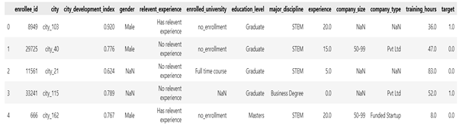

Slide 8
03
MISSING DATA HANDLING METHODS

Slide 9
3.1
COMPLETE CASE ANALYSIS (CCA)

Slide 10
The primary goal of CCA Imputation is to estimate the missing values in the dataset by leveraging the correlations between the variables with missing data and the other relevant variables in the dataset. By utilizing the relationships between these variables, the CCA Imputation method attempts to provide accurate and informed imputations while preserving the underlying structure and patterns in the data
Evaluation and Considerations :
While the CCA Imputation method can provide valuable imputations, its effectiveness heavily relies on the appropriate selection of predictor variables. Careful consideration must be given to the choice of predictor variables to ensure meaningful and accurate imputations.
Furthermore, it is essential to assess the quality and reliability of the imputed values. This evaluation can be conducted by comparing the imputed values with the original data (if available) or by analyzing the imputed data in combination with other analyses or modeling tasks.

Slide 11
3.2
MULTIVARIATE IMPUTATION

Slide 12
3.2.1
KNN IMPUTATION

Slide 13
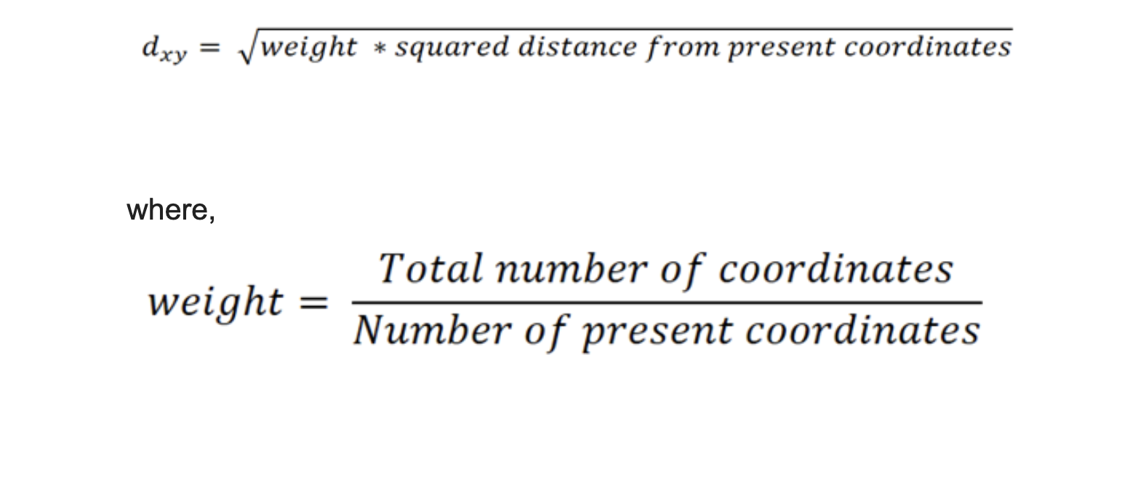
K-Nearest Neighbors imputation is a simple yet effective technique for filling in missing values in a dataset. The basic idea behind KNN imputation is to use the values of "k" nearest neighbors of a data point with missing values to estimate the missing entry.

Slide 14
3.2.2
ITERATIVE IMPUTATION

Slide 15
Iterative Imputation, also known as Multiple Imputation by Chained Equations (MICE), is a popular method for dealing with missing data in statistical analysis and machine learning. It is an iterative approach that imputes missing values by creating multiple imputed datasets based on the observed data. One of the techniques used within MICE is Round-Robin Linear Regression. Robin Linear Regression.
Iterative Imputation using Round-Robin Linear Regression is used to handle missing values in the dataset. The term "Round-Robin" implies that the imputation is done in a cyclical manner, where each column with missing values is imputed in a sequence, and the process is repeated until convergence or a predefined number of iterations. The missing values in each column are predicted using linear regression models that are trained on the available data in other columns.

Slide 16
3.2.3
ARBITRARY VALUE IMPUTATION

Slide 17
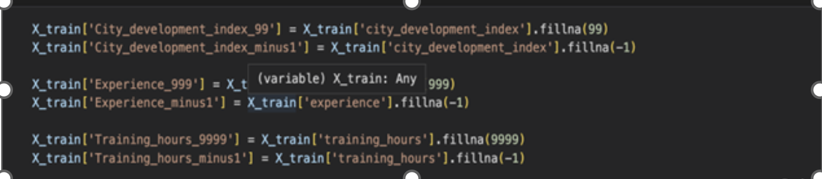
Arbitrary value imputation is a type of data imputation technique used in machine learning to fill in missing values in datasets. It involves replacing missing values with a specified arbitrary value, such as 0, 99, 999, or negative values. Instead of imputing the numbers using statistical averages or other methods, the main goal is to flag the values. .

Slide 18
3.2.4
FREQUENCY VALUE IMPUTATION

Slide 19
Frequent value imputation, also known as mode value imputation, is a technique used to fill in missing values in a dataset by replacing them with the most common value (mode) of the respective feature. When dealing with real-world datasets, it is common to encounter missing data, which can be problematic when performing data analysis or training machine learning models since many algorithms cannot handle missing values.

Slide 20
04
CONCLUSION

Slide 21
Missing data is a real-world challenge that can be encountered in various practical scenarios across different fields
In practical terms, addressing missing data requires a thoughtful approach that strikes a balance between preserving valuable information and avoiding biased results. Complete case analysis, while simple, may not be the best choice, as it often leads to data loss and potential skewing of results. Instead, employing appropriate imputation techniques, such as mean imputation for numerical data or mode imputation for categorical data, can help fill in missing values based on existing information
In conclusion, addressing missing data practically involves adopting appropriate imputation techniques while considering the context of the dataset and the implications of the missing data mechanism.

Slide 22
05
REFERENCES

Slide 23
[1] https://www.kaggle.com/code/parulpandey/a-guide-to-handling-missing-values-in-python
[2] https://www.analyticsvidhya.com/blog/2020/07/knnimputer-a-robust-way-to-impute-missing-values-using-scikit-learn/
[3] https://towardsdatascience.com/a-better-way-to-handle-missing-values-in-your-dataset-using-iterativeimputer-9e6e84857d98
[4]
https://pubmed.ncbi.nlm.nih.gov/22218574/
[5] https://github.com/campusx-official/100-days-of-machine-learning/tree/main
[6] Dataset: https://github.com/campusx-official/100-days-of-machine-learning/blob/main/day35-complete-case-analysis/data_science_job.csv

